Slide 1
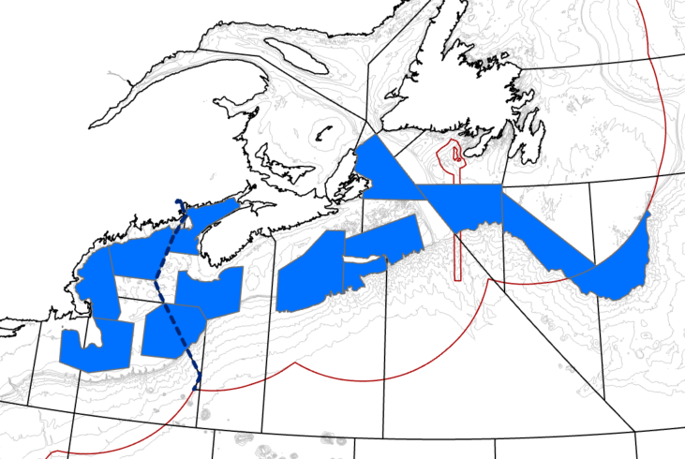
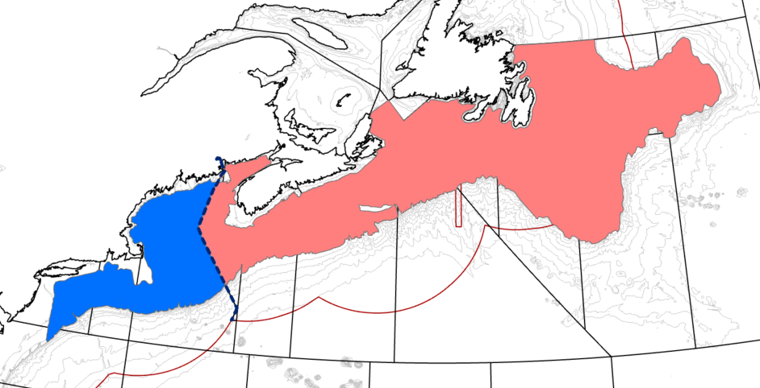
Tagging, largest export is 4x,
Removing :MA, and ME_NH (too close to shore)
winter NF: only available winter data: lowest sample intensity, representing 15% of the available NF data 66/4793 P (1.3%)
1990-2023
Cuttin data in north and south extremities.
Justify northern and southern
- Presence Absence map of zero to define where they start showing up
boundaries
South- Grasso, historic fishery not mentioned below Nantucket
Expectation that they move NE,
Increase accuracy by adding 0…so go one nafo beyond the understood range edge in NF

Slide 3
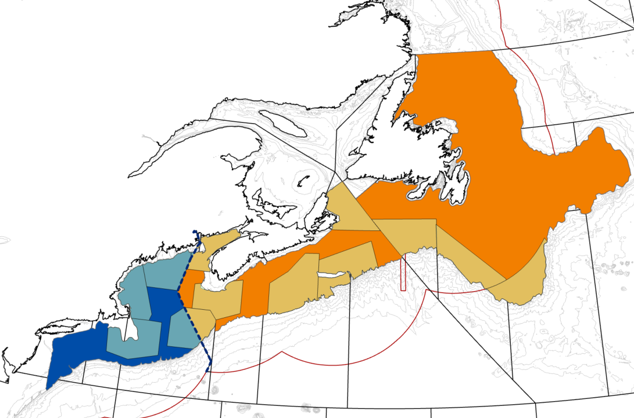

Slide 4
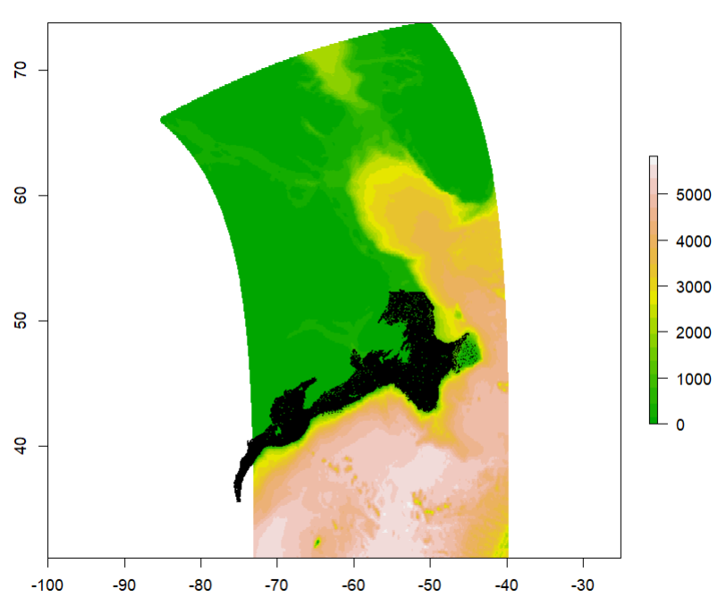
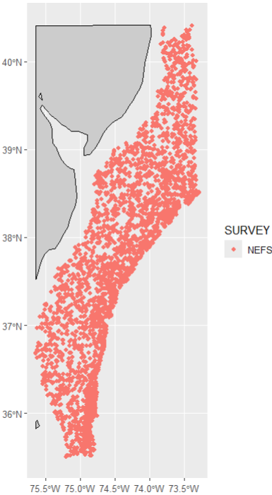
BNAM available until 2023, losing a small
amount of data at southern range
Increase newfoundland side by one NAFO

Slide 5
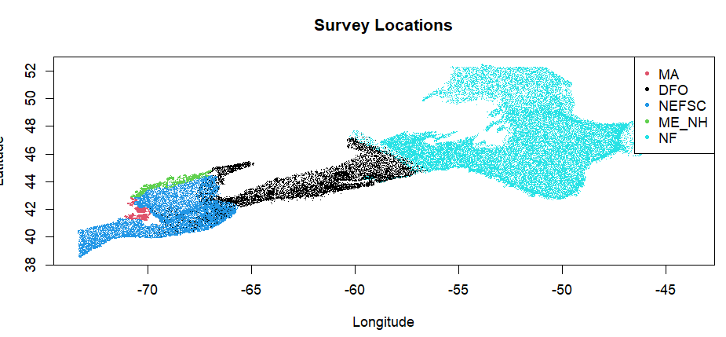
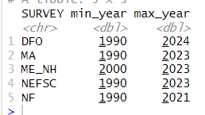
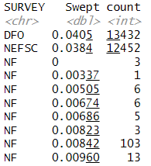
Need to handle unbalanced temporal coverage…removed ME_NH, but NF does not reach 2023
so define obsModel to allow missing years and set PREDTF_I to not overweight missing years
Supply a_i = $Swept
Removed Winter

Slide 6


